Slide 1
CO5-I A1
Guide:- Shahista ma’am
Team :- Sajiya Shaikh,
Mohamed Qais Sahib ,
Mahek Shirgawkar ,
Saniya Inamdar ,
Sohail Shaikh.

Slide 2
Simulation Game
Our topic is a simulation game.
There are many types of simulation i.e. Construction simulation, Life simulation, Sports, etc.
We chose to make Sports

Slide 3
First Person Runner
FPR is a runner game where you will compete with other runners or rather bots or AI
This game will feature an athlete running a race
This game will be a first person game so it will be more of a simulation of a person running
We have decided to make a simulation of running race.
We have increased the performance by decreasing the poly of the character

Slide 4
Literature Theory
Racing video game is the genre in which the player participates in a racing competition with any type of land, water, air, or space vehicles.
They may be based on anything from real-world racing leagues to fantastical settings.
They are distributed along a spectrum between simulations and simplified arcade-style racing games.

Slide 5
There are many genre of racing video games , these are the following:-
Arcade-style racing:-
fun and a fast-paced experience.
A key feature of arcade-style.
Simulation Racing:-
Simulation style racing games.
They often license real cars or racing leagues, but will sometimes use fantasy cars built to resemble real ones if unable to acquire an official license for them.

Slide 6
Kart Racing:-
Driving mechanics.
Kart racers are also known to cast characters.
But we are trying to take this to the next level
FPR will be the first game with first person running race its will a genre itself

Slide 7
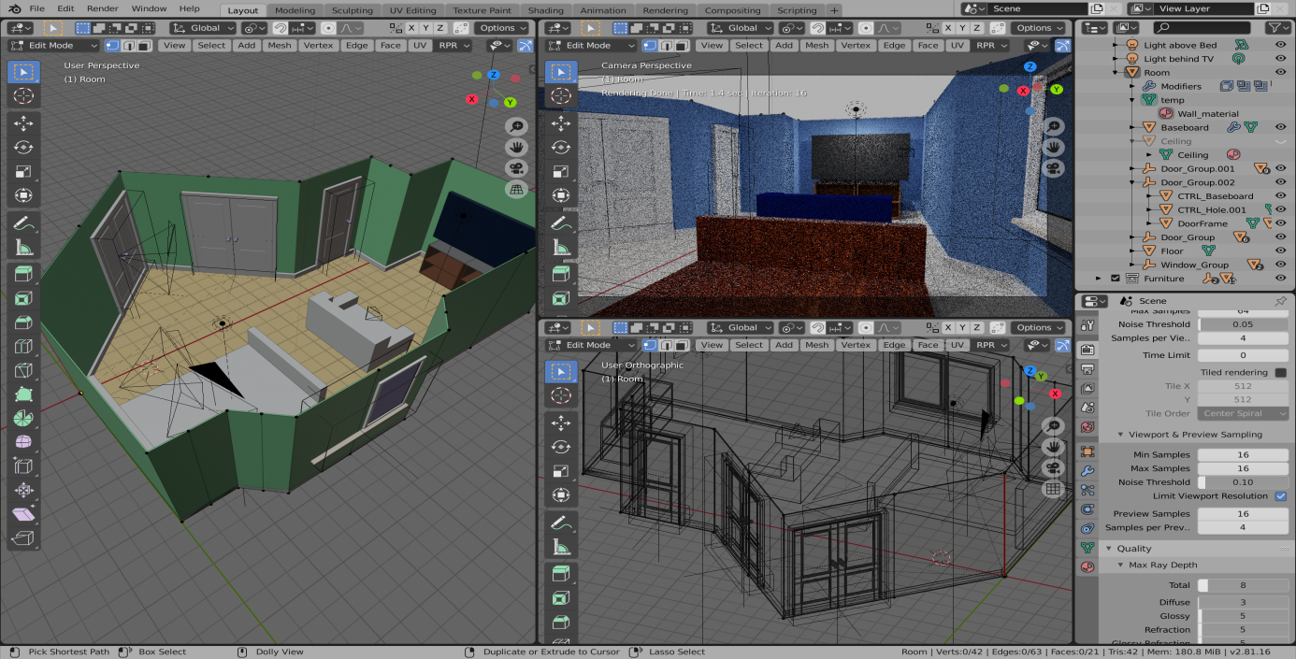
Modules of this project
Blender :-
This software will help us to make our 3D assets or object (Character, environment, etc)
It will also help us to create character animations

Slide 8

Visual Studio:-
We write our program in visual studio.
The programming language that we are going to use is C#.
Program will be used to make the key binding and to make an animation is a loop or if there is a condition the player must finish to get to next level.

Slide 9

Unity:-
Unity is a software where we will integrate our program with the objects or assets .
Here is where the object will come to life and interact with other object.
With this software this game will be actually made .

Slide 10
Disadvantage
After you start earning you have to pay the application to keep using it
If your project is big you have to make sound which you can not make by yourself , for that you have to hire people for the sound track
It is less costly but when you start earning by a game it becomes more costly to make another

Slide 11
Scope
The scope of this project is to make a game which is a running race in a first person prospective which will be the first of it’s kind .
This game will not have very detailed graphics because our main priority is the performance of the game.
The AI or Bots in this game will be harder to beat as your level increases, But there will still be some bots to ensure that the player will not come last in the game.

Slide 12
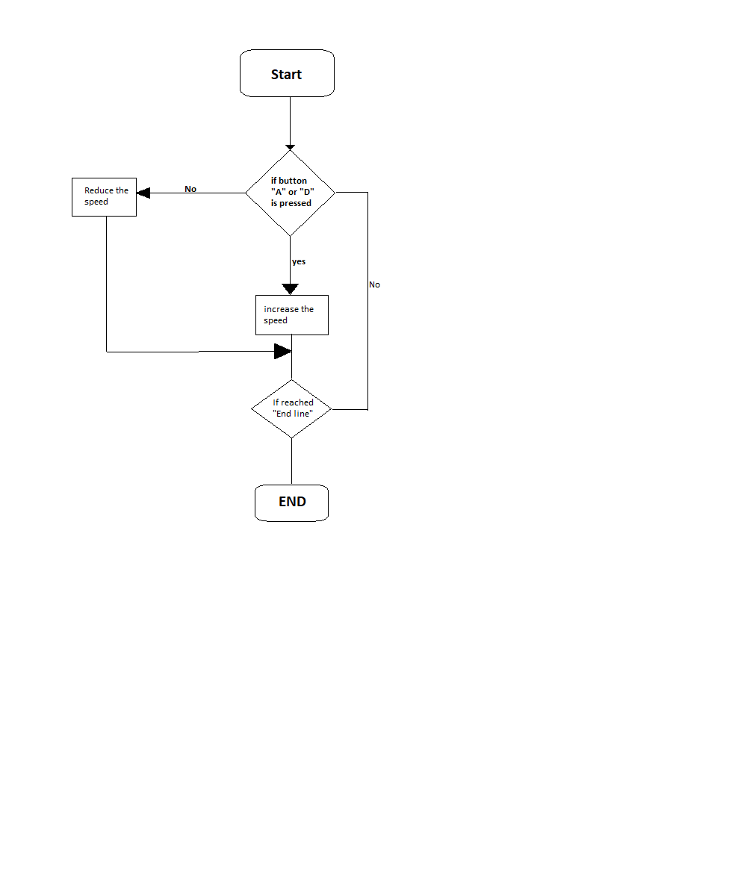
Flowchart
Controls

Slide 13
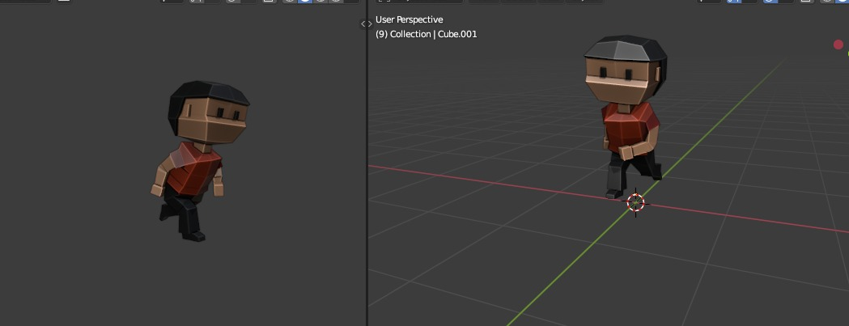
Characters
James Jacob

Slide 14
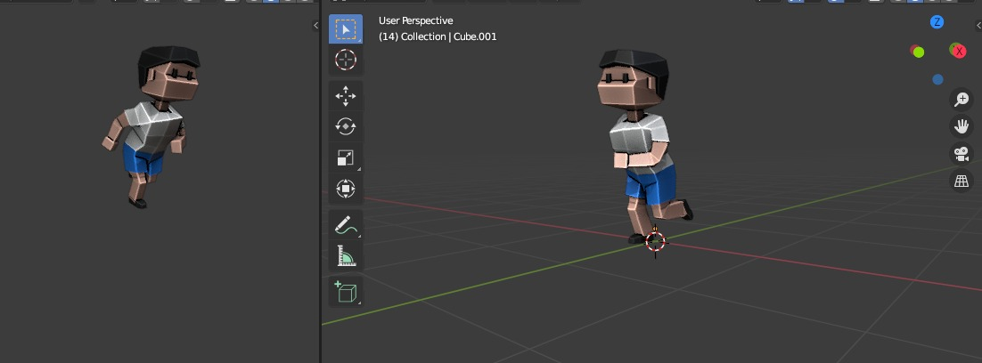
Carlos White

Slide 15
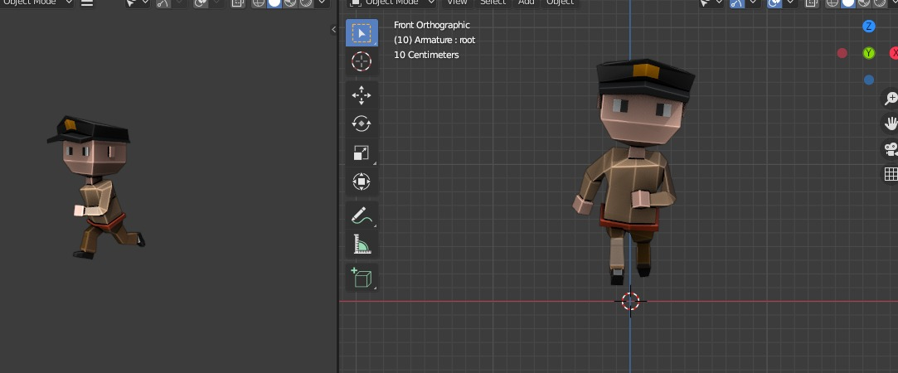
Peter Cop

Slide 16
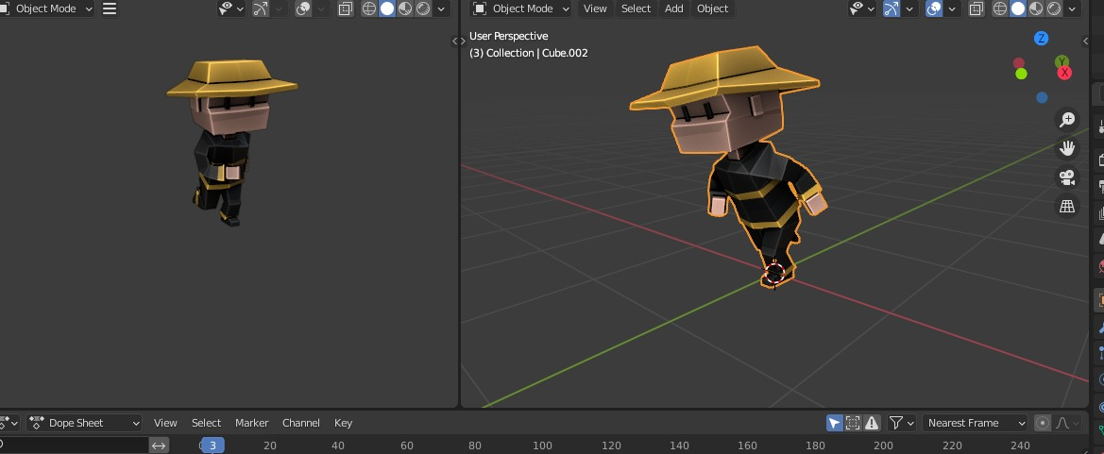
Dextr Morgon

Slide 17
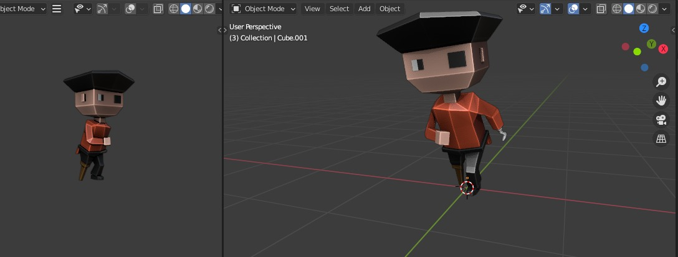
Pirate Jack

Slide 18
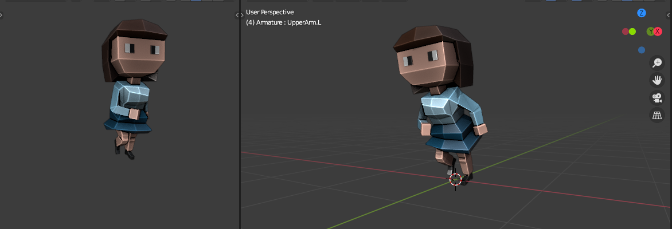
Alexby

Slide 19
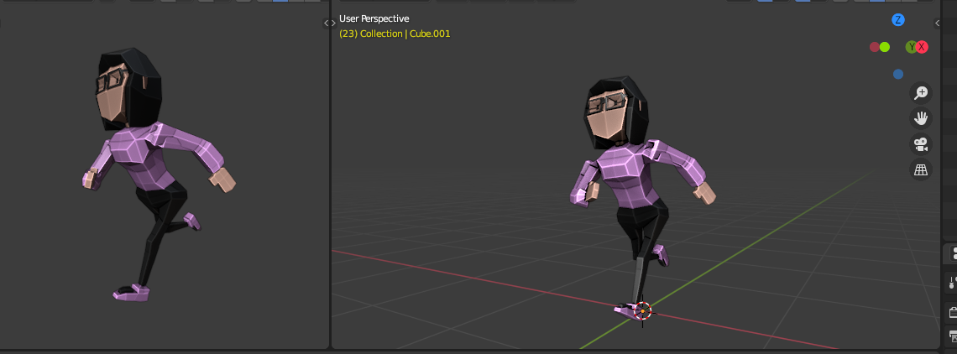
Caffeine Cathy

Slide 20
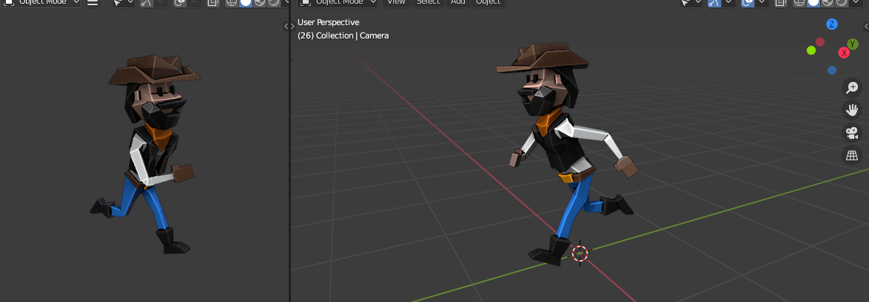
Hipshot Henry

Slide 21

Character animation
Crouch start

Slide 22
Running animation

Slide 23
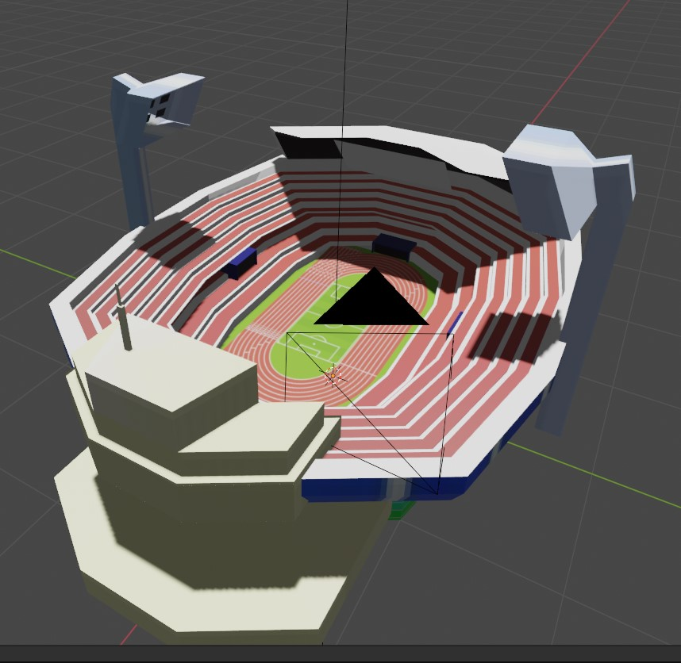
Stadium

Slide 24
THANK YOU

